Slide 1

Topic Modeling of News Articles and Comments

Slide 2
Technical Importance of the Project

Slide 3
Questions to Answer
What are the top topics mentioned in the articles and comments? What is the overlap?
What are the most mentioned people, places, organizations in the articles and comments? What is the overlap?
What are the sentiments expressed in the comments for the articles? Time-series analysis of the sentiments expressed in articles and comments.

Slide 4
SFU linguistic department
SFU Opinion and Comments Corpus data set.
from the main Canadian daily in English, The Globe and Mail, for a five-year period (from January 2012 to December 2016).
663,173 comments
10,339 articles
https://github.com/sfu-discourse-lab/SOCC

Slide 5
Give a High-level Idea on How to use Data Science skills to answer our Questions
Pandas dataframe, PySpark.Sql
PySpark.ML (StopWordsRemover, Tokenizer)
CountVectorizer, IDF from PySpark.ML.
NLTK (Stopwords, WordNetLemmatizer)
Gensim
Evaluation of the data
Cleaning comments/
Articles text
Words Vectorization
PySpark.mllib.clustering LDA, Gensim LDA, nmf (sklearn)
NLTK (iob tagging), tagger (github)
matplotlib.pyplot
PyLDAvis Gensim, Plotly, sklearn(clustering)
Topic Modeling,
Sentiment Analysis (VADER),
NER (3 class, IOB)
Vizualization

Slide 6
Results and Conclusions
Most popular TOPICs on 663,173 Comments
TOPIC 1 canadian and world culture and values.
TOPIC 2 legal issues and its prosecution and government
TOPIC 3 jobs, salary and government
TOPIC 4 governmental expenditures.
TOPIC 5 canadian government and its economy
TOPIC 6 canadian worldwide government and political elections and etc.
Most popular TOPICs on 10,339 Articles
TOPIC 1 women, time, work, men – femenism appeared in ~ 1200 articles
TOPIC 2 party, election, liberals, governmen: appeared in ~ 980 articles
TOPIC 3 world politics: appeared in ~ 960 articles
TOPIC 4 war, terrorism, defense: appeared in ~ 780 articles
TOPIC 5 policy, law: appeared in ~ 610 articles
TOPIC 6 tax, economy issues: appeared in ~ 600 articles

Slide 7
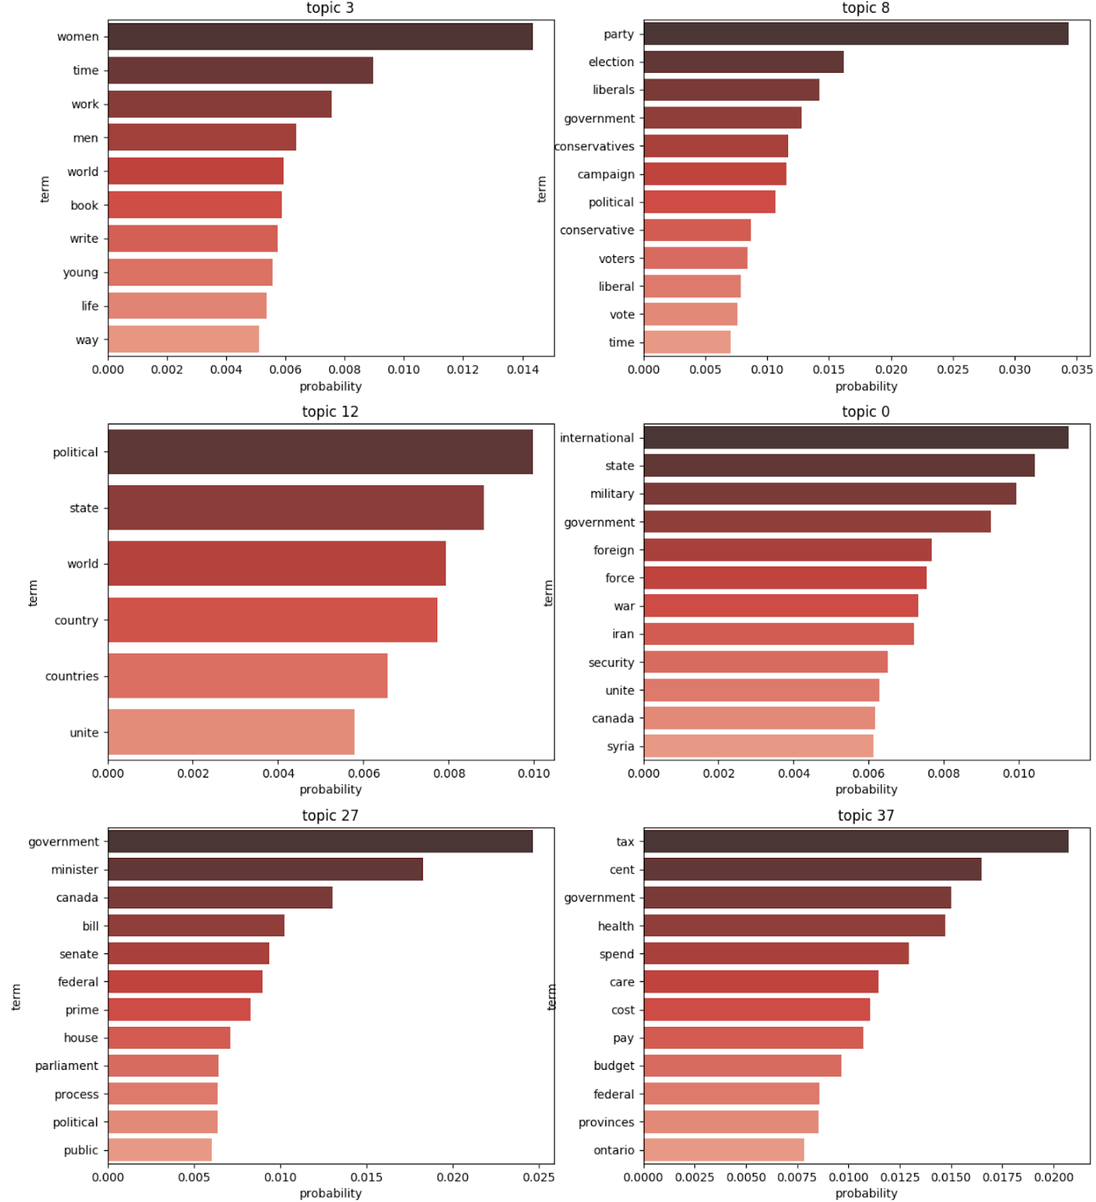
Top Topics in Articles

Slide 8
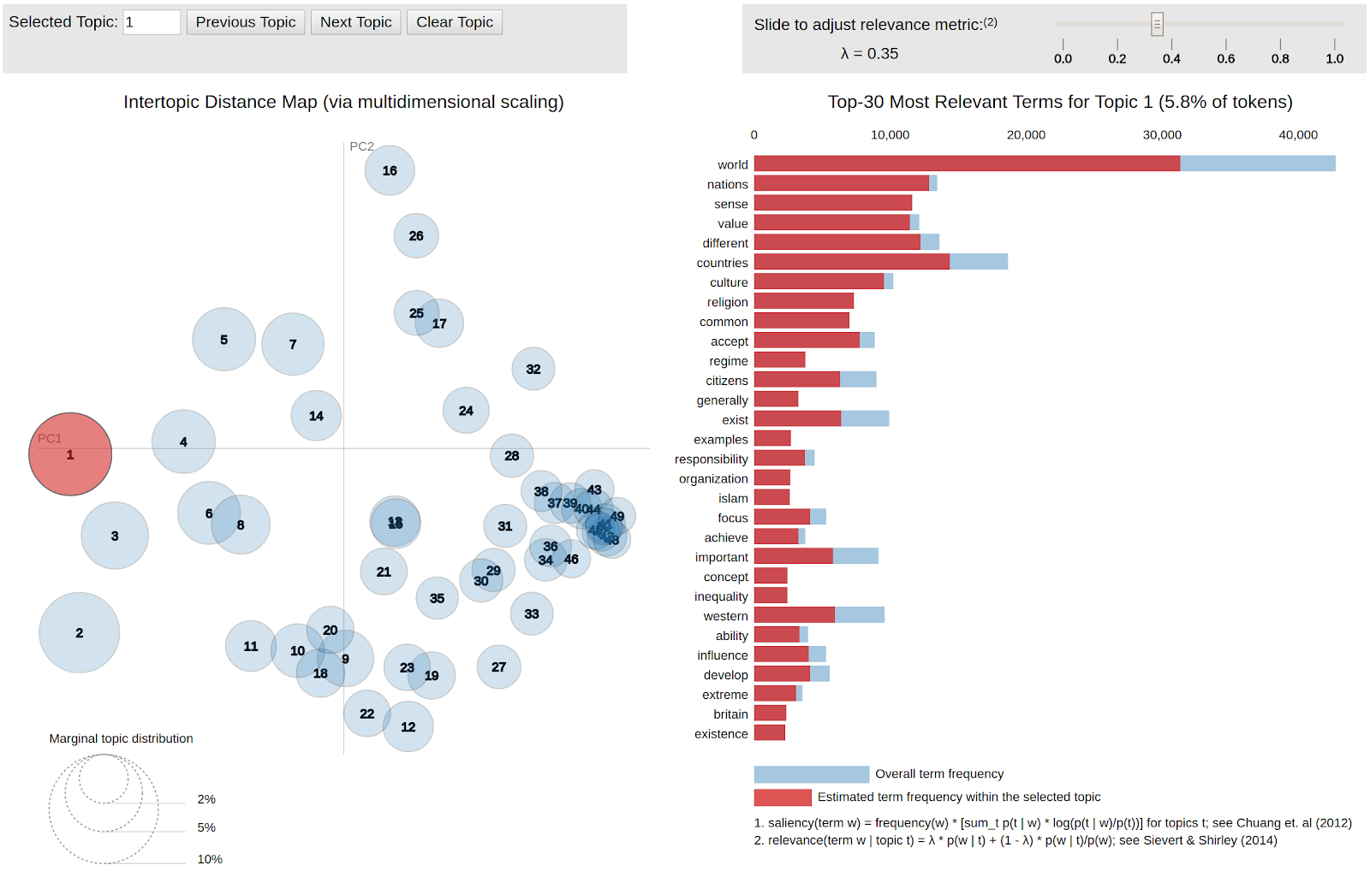
Top Topic in Comments

Slide 9
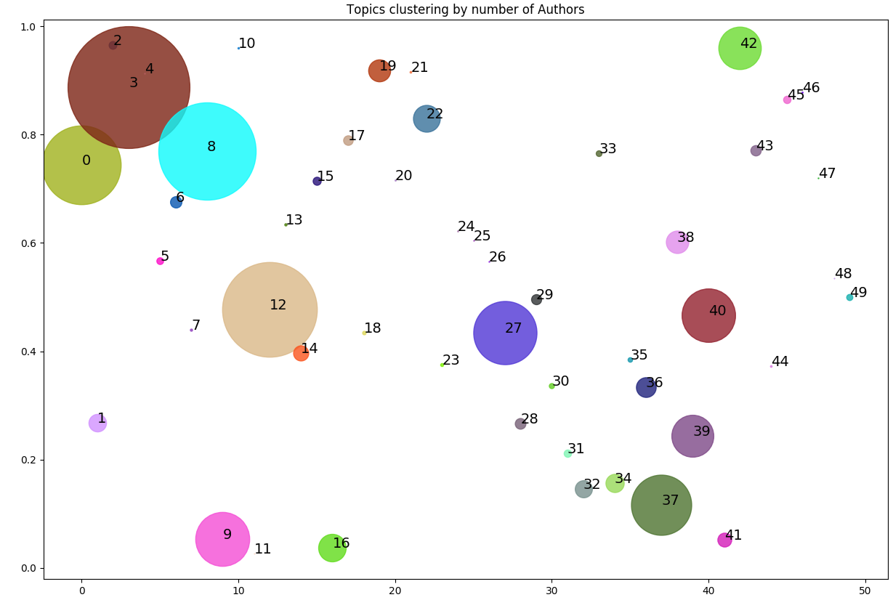
Overlap of Topics among Authors

Slide 10
Sentiment Analysis
Date | Sentiment Score | Articles Released
2013-12-03 | 0.37 | It's time for the Green Party to pack it in Quebec adds, Canada subtracts on its math scores
2014-09-06 | 0.34 | Suddenly, I'm the oldest person in the room - and I love it
2013-08-11 | -0.5 | Police use of force and a promising investigation
2014-11-01 | -0.45 | How misogyny can become terrorism Don't try to separate abortion from maternal health
Notes:
Here are some days with most positive and negative sentiments of the comments. The positive sentiments mostly come from articles with positive titles (such as ‘I love it’). The negative sentiments come from titles that deliver negative news (such as ‘force’, ‘misogyny’, ‘abortion’).

Slide 11
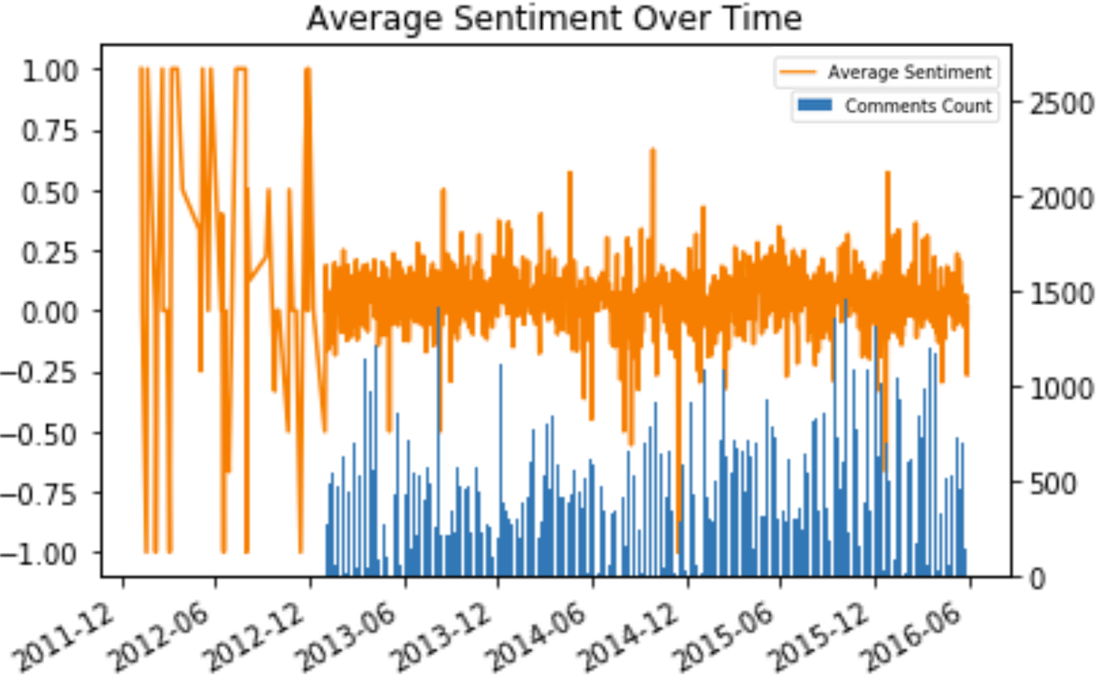
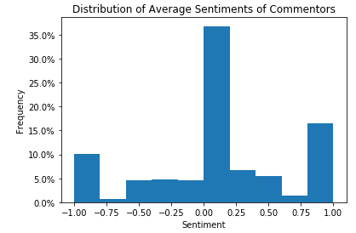
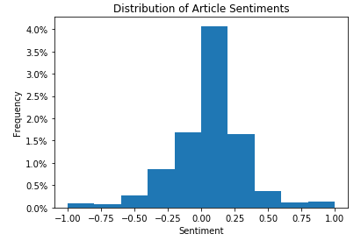
Sentiments and it’s Time Series Analysis

Slide 12
Popular Named Entities
Named Entities in Articles
University, Global, School, International etc.
Talks about the advent of international education.
Harper, Trudeau, Economy, Canada etc.
Talks about Canadian economy and policy makers.
Named Entities in Comments
Liberal, Mail, Stephen, Money.
Talks about the liberal community and the economist Stephen harper .
Harper, Trudeau, Economy, Canada etc.
Talks about Canadian economy and policy makers.
Named Entities in Both
Margaret, Ontario, john, Trudeau etc.

Slide 13
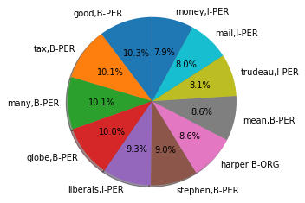
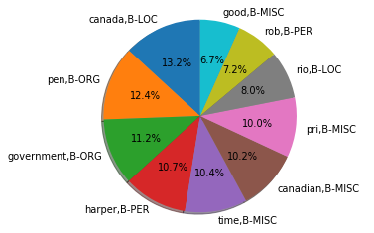
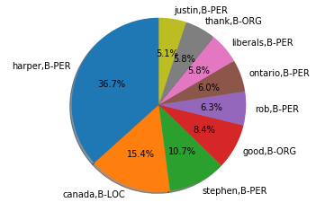
Popular Entities in the Data
Entities in Comments
Entities in Articles
Entities in Both

Slide 14
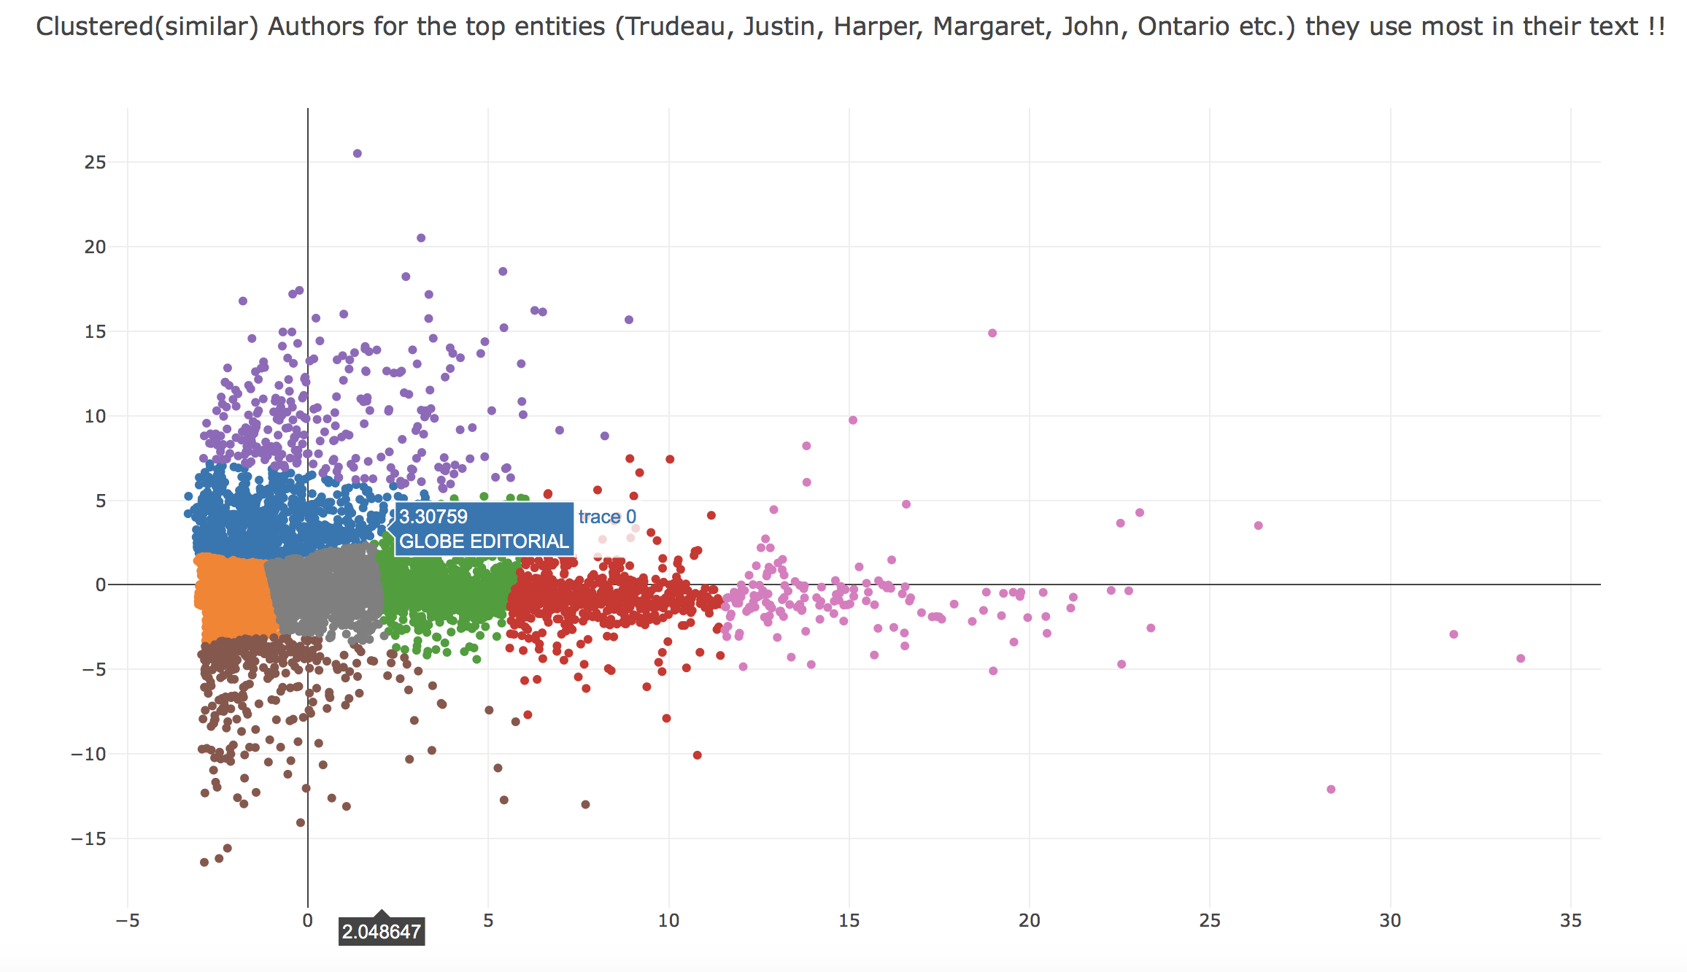
Similar Authors based on Entities they Use

Slide 15
Contact Information
Andy Chen
andy74322@gmail.com
+1 (778)–997–8252
Maria Babaeva
maraik26@gmail.com
+48 (539)–870–130
Pushkar Sinha
pushkarsinha089@gmail.com
+1 (778)–865–6772

